Slide 1
YouTube Comments Summarizer

Slide 2
AGENDA
INTRODUCTION
STATEMENT OF PROBLEM/OPPORTUNITY
PROBLEM IDENTIFICATION IN THE DOMAINDATA
COLLECTION APPROACHES/STRATEGIES DATA ANALYSIS APPROACHES
CONCLUSION FINDINGS AND INTERPRETATION
REFERENCES

Slide 3
INTRODUCTION
In recent years, YouTube has gained huge popularity among content creators. Many content creators upload their video content on this platform. These videos get tons of views and comments.
The content creators, more generally called YouTubers, need to continuously work on maintaining the quality and quantity of their contents. To do so, they must collect feedback from their viewers through the comments section. This feedback lets them understand the influence of their creations.
In addition to improving audience engagement, feedback also provides information on the aspects of the content that need improvement.
However, not all YouTubers have enough time to go through all the comments on individual video. On the contrary, they must read all the comments to fully understand the public interest on their content.
The solution to this inconvenience is addressed in our work. Our approach is to extract all the comments from a video and summarize them into multiple categories

Slide 4
STATEMENT OF PROBLEM/ OPPORTUNITY
YouTube has been growing vastly ever since JIO entered the market. Many people chose YouTube as a profession by posting various content in various disciplines.
Covid-19 lockdown has been a major shift in which people started making content in YouTube and started generating revenue from it. People of all ages started consuming content from YouTube and they express their views about the videos in the comment box.
YouTubers with large number of subscribes get a huge number of comments which they can’t read but it is essential to know what people think about their content to make better contents for their subscribers.
So, in order to solve this problem, we tried to summarize the YouTube comments by getting the YouTube comments through its API

Slide 5

PROBLEM IDENTIFICATION IN THE DOMAINDATA
These categories can help YouTubers focus only on those comments that suit their interest. Consequently, it is a challenging task to categorize the comments into different sentence types because of various factors such as non-standard language, spelling errors, unformatted texts, and trivial comments.
Apart from these, sometimes there are multiple sentences of different classes on a single comment. The combination of these issues poses a unique challenge in sentiment analysis based on sentence types.

Slide 6
COLLECTION APPROACHES/STRATEGIES DATA ANALYSIS APPROACHES
We will be using YouTube API to extract comments quickly. We have a parameter called ‘order’ using which we can select the order by which the comments is extracted.
By giving it as “relevance” we can extract comments which has a greater number of number of likes and comments. After extracting the comments from the video, it is much unstructured because it has many information in it along with the comment.
So, we will be extracting the comment alone separately and clean the comments to load into the models

Slide 7
METHODOLOGY
Since YouTube comments don’t have to labels to train it with machine learning model, we tried a method called Zero shot classification to predict the classes of the YouTube comments with a pre- trained model. We tried two methods of summarization:
Extractive Summarization
Abstractive Summarization
It takes the text, ranks all the sentences according to the understanding and relevance of the text, and presents you with the most important sentences. This method does not create new words or phrases, it just takes the already existing words and phrases and presents only that. You can imagine this as taking a page of text and marking the most important sentences using a highlighter.
It tries to guess the meaning of the whole text and presents the meaning to you. It creates words and phrases, puts them together in a meaningful way, and along with that, adds the most important facts found in the text. This way, abstractive summarization techniques are more complex than extractive summarization techniques and are also computationally more expensive.

Slide 8
LITERATURE SURVEY
Taboada et al. implemented a lexicon-based method for sentiment analysis. In this study, a dictionary of words was created, and the words were manually ranked on a scale of -5 to +5 (negative to positive mood).
Our supervised learning approach replaces the manual work done in the classification step of the approach, improving accuracy. The time-consuming process of manually scaling words has also been automated by a machine learning approach.
Our research classifies texts by both sentence type and mood. Siersdorfer et al. We used a linear support vector machine together with a thesaurus to obtain the level of negativity and positivity for each word from the comments. Their approach has an accuracy of 0.72. We were able to improve the accuracy of our sentiment analysis model without using a thesaurus.
Similarly, Krishna et al. used naive Bayesian classification for polar analysis (sentiment analysis) of the IMDB dataset. Their approach leverages each comment's category during the feature selection process. In other words, the polarity of a new comment cannot be calculated without knowing its category. However, our approach does not use categories during the feature selection process.

Slide 9
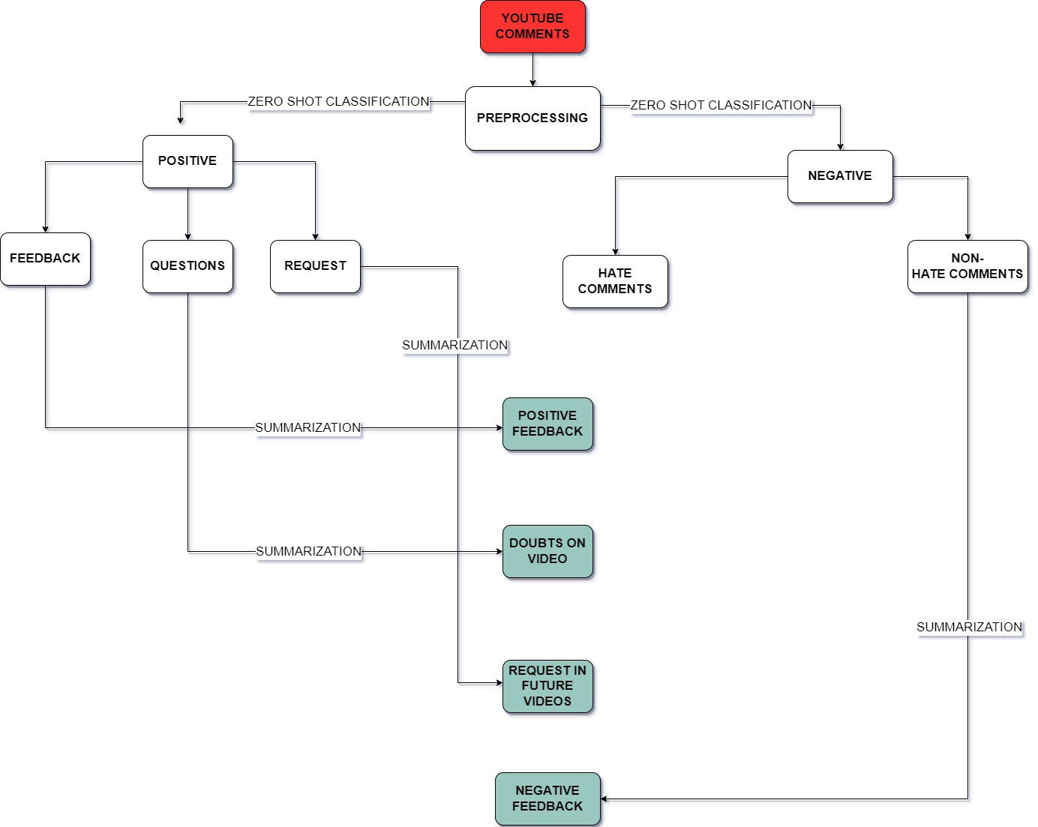
FLOW CHART

Slide 10
SYSTEM DESIGN
We used YouTube API to extract comments quickly. We have a parameter called ‘order’ using which we can select the order by which the comments is extracted.
By giving it as “relevance” we can extract comments which has a greater number of number of likes and comments. By giving the video link in the parameter called ‘videoId’ we can extract the comments of the video we want. After extracting the comments from the video, it is much unstructured because it has many information in it along with the comment.
So, we need to extract the comment alone separately and clean the comments to load into the models

Slide 11
ZERO SHOT CLASSIFICATION
Yin et al. used pre-trained NLI models as zero-shot sequence classifiers. The method poses the sequence as the NLI premise and builds a hypothesis from each candidate label.
For instance, we could hypothesis that a sequence is about politics to determine its class. Entailment and contradiction probabilities are then labelled.
This method is surprising effective, especially with larger pre-trained models like BART and Roberta.
This technique splits preprocessed comments into positive and negative by labelling them, then calculates the probability of each comment being in each class.

Slide 12
ZERO SHOT CLASSIFICATION
The above text is likely positive. We classified all comments as "Positive" or "Negative" using unsupervised classification. Positive comments are reclassified as "Feedback," "Questions," and "Request." These classified comments are summarized using extractive and abstractive methods.
Negative comments are sorted into "Hate" and "Non-Hate" and then discarded. Users receive negative feedback for non-hate comments.
Positive Feedback and Subscriber Questions are displayed. Subscriber video requests are shown in the Request class. Each class's output is summarised.

Slide 13
CODING / IMPLEMENTATION

Slide 14
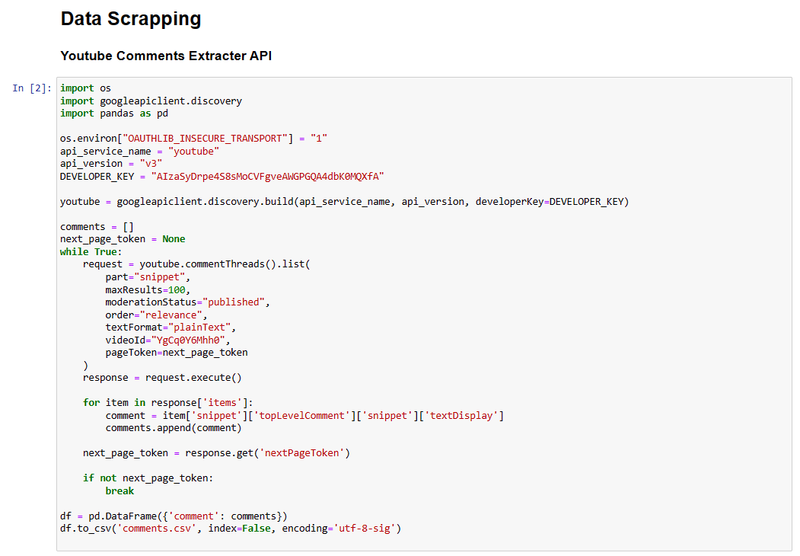

Slide 15
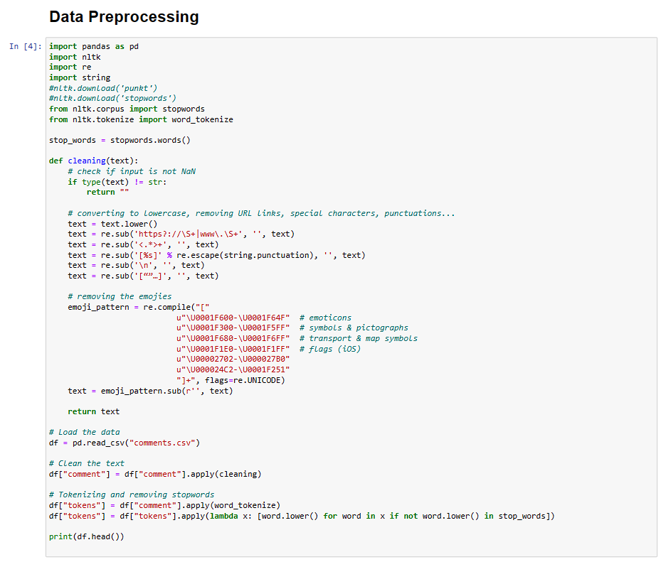

Slide 16
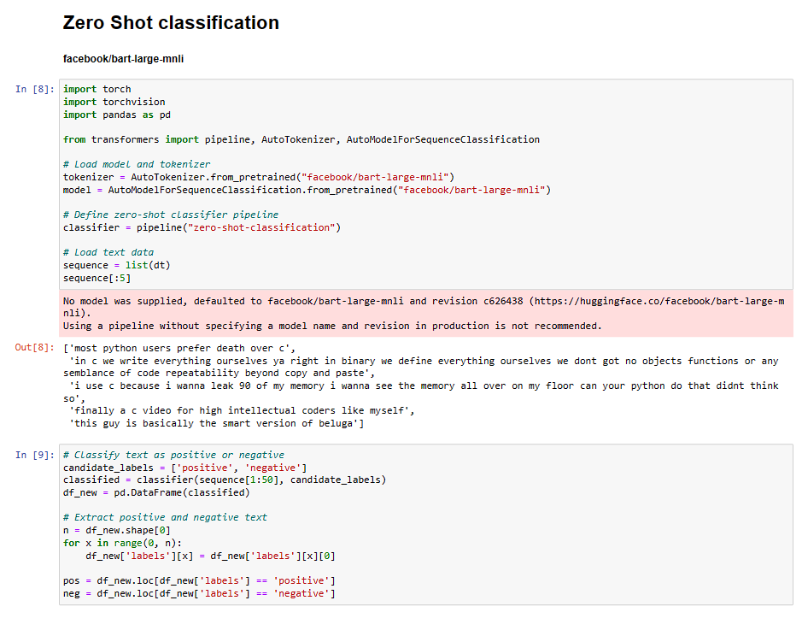

Slide 17
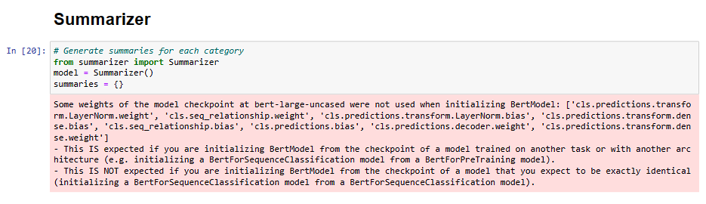
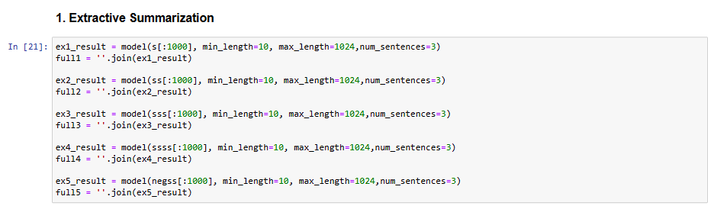
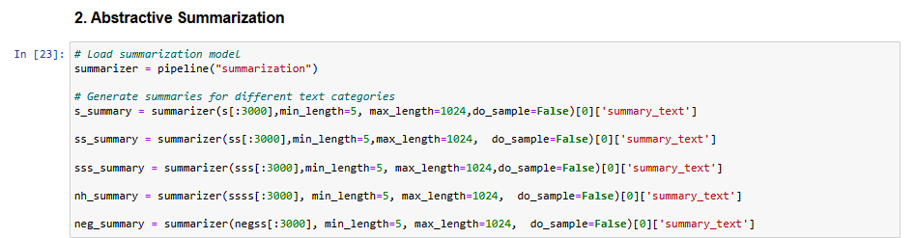

Slide 18
VISUALISATIONS

Slide 19
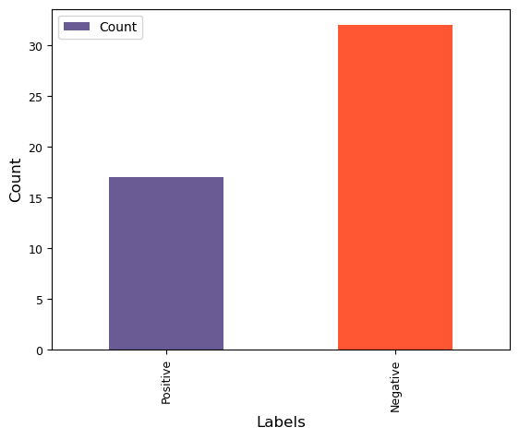

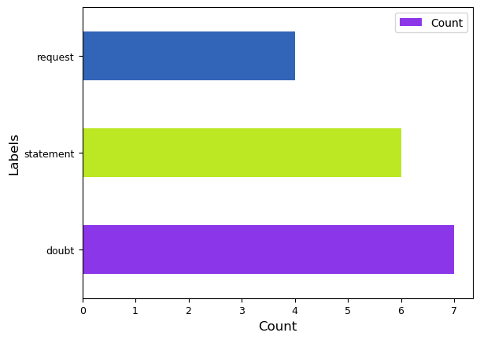
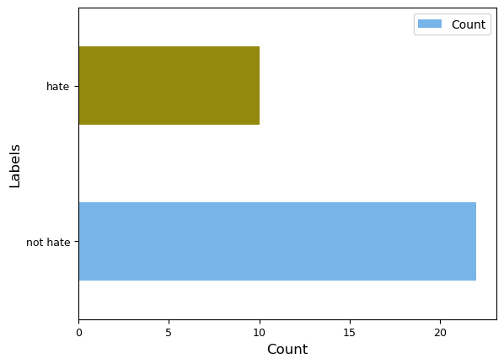


For this video (24) C++ Coders Be Like... – YouTube we analyzed top 50 comments based on relevance and we got the given comment type distributions shown.

Slide 20
WEBSITE IMPLEMENTATION

Slide 21
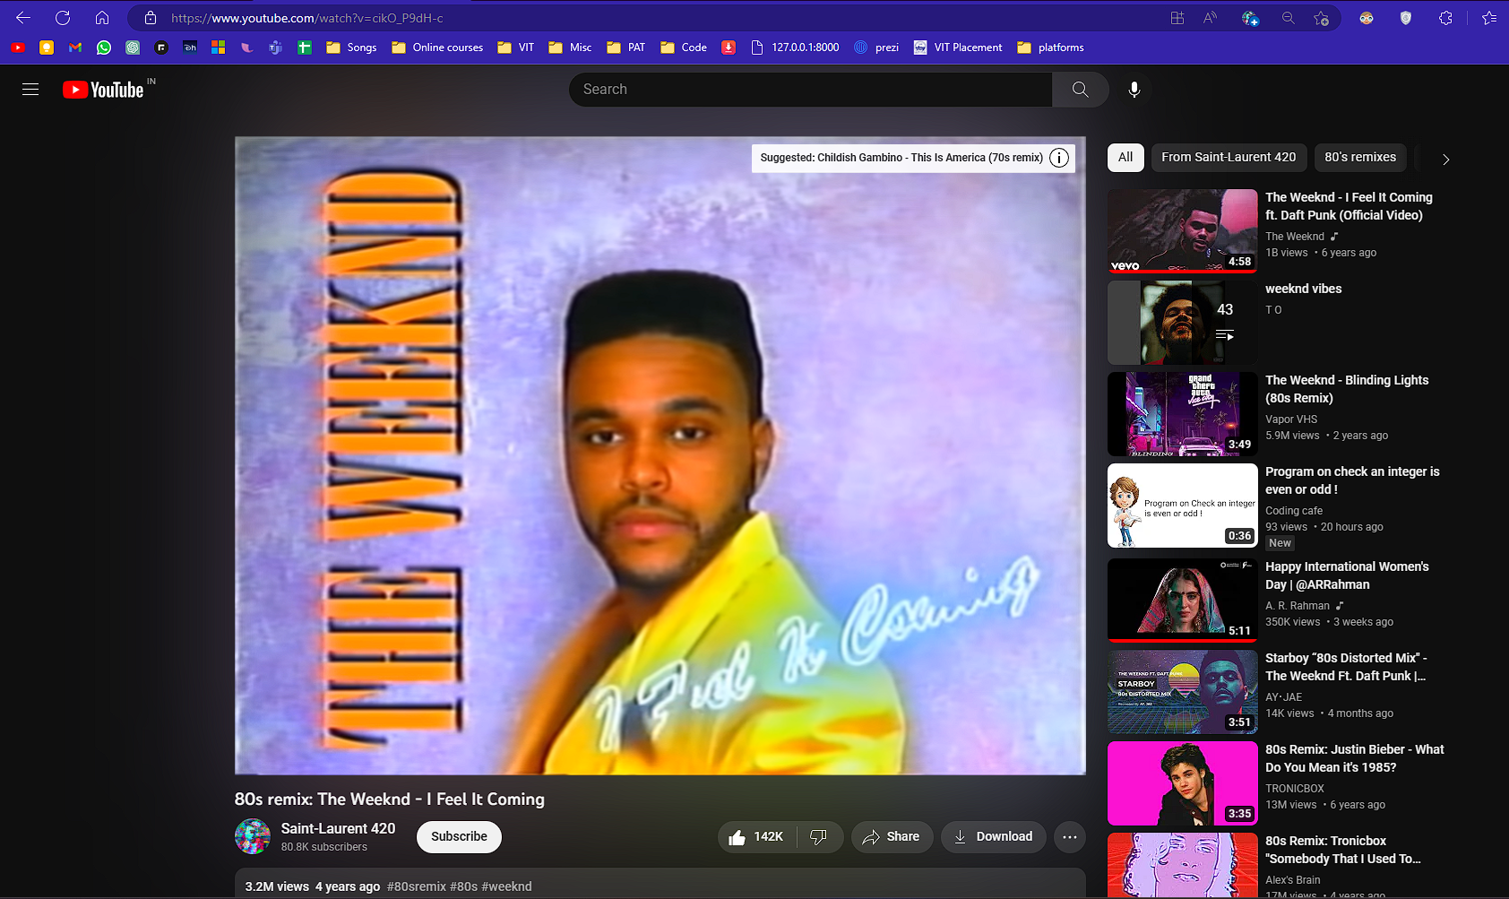

Slide 22
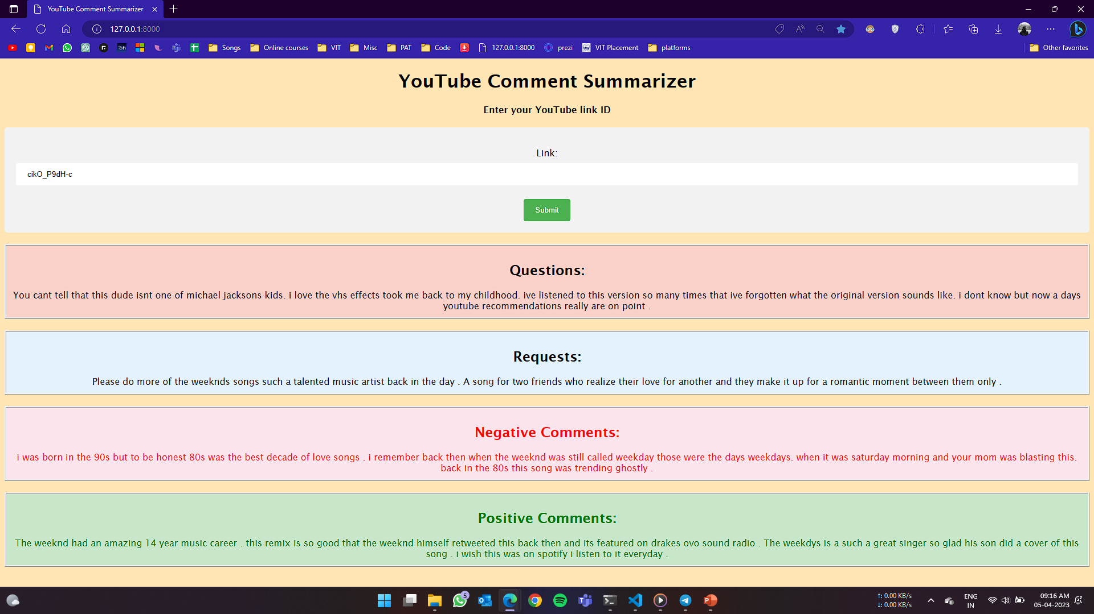

Slide 23
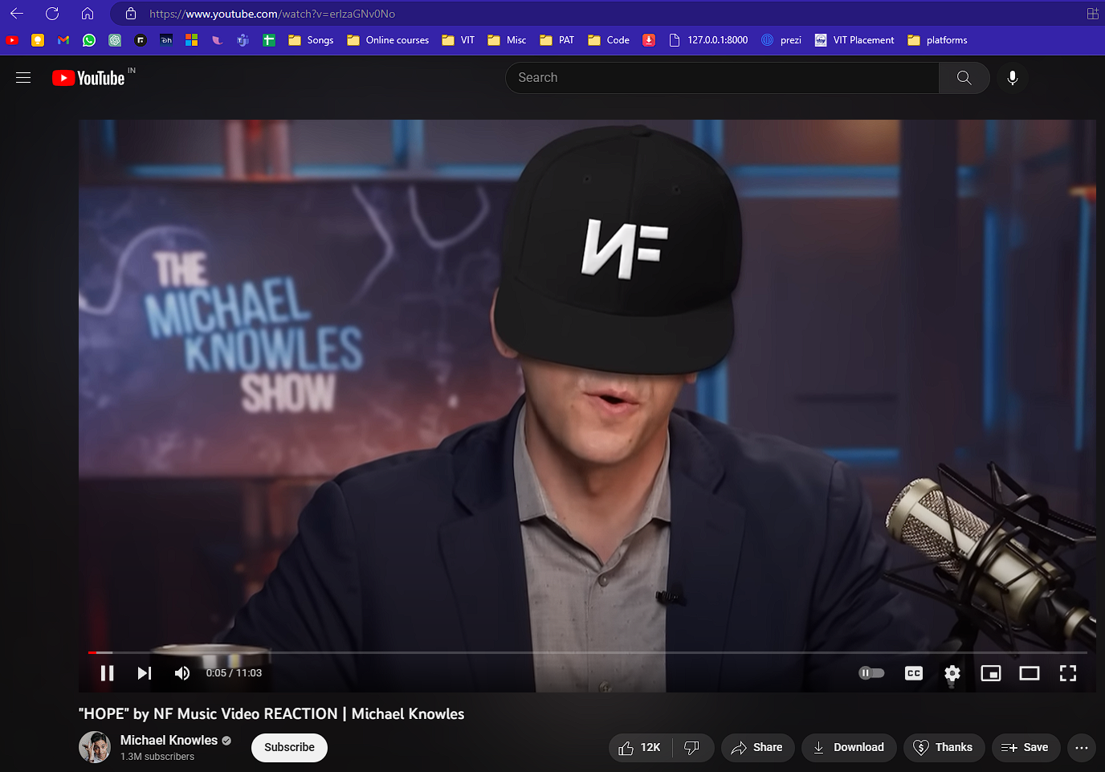

Slide 24
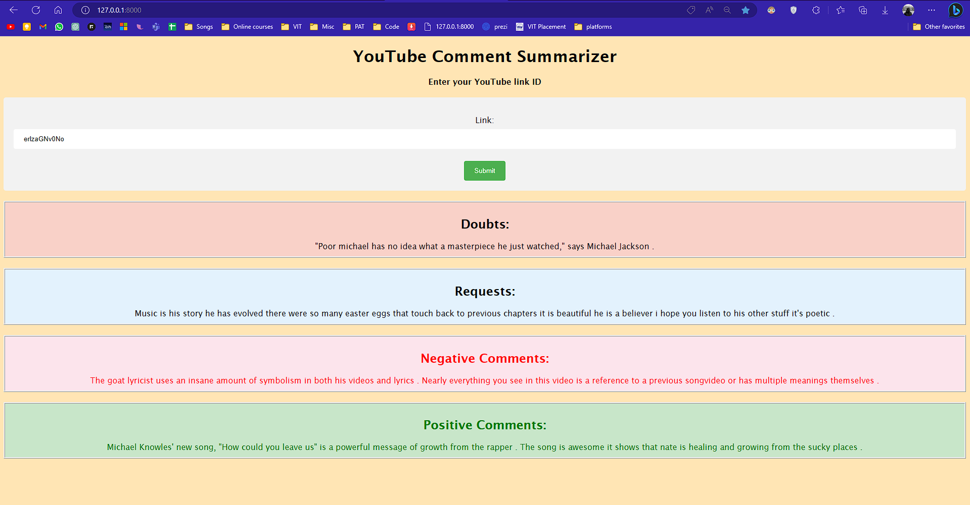

Slide 25
CONCLUSION FINDINGS AND INTERPRETATION
This project will be summarizing the comments into their respective categories using Abstractive summarization technique and Extractive summarization technique.
A YouTuber can easily access each category of comment. The positive and negative category show the subscribers expectation and views on that particular video.
Other categories aid the YouTuber to distinctly view the questions asked about the video and the suggestions provided to improve the content.
This can help the YouTuber to avoid scrolling through hundreds of comments and filtering them manually for each video. While previous researchers focused either on sentiment analysis or classification of sentence of a niche, we have incorporated classifying and summarizing.

Slide 26

References
1. https://analyticsindiamag.com/a-complete-tutorial-on-zero-shot-textclassification/
2. https://towardsdatascience.com/zero-shot-text-classification-with-huggingface-7f533ba83cd

